Slide 1

Gokaraju Rangaraju Institute of Engineering and Technology (Autonomous) Department of Computer Science and Engineering(AI&ML) Major Project Phase - 2
VISIONCARE Vision-Based Real-Time Patient Monitoring System
Under the Guidance of
Mr. Ramesh Banoth
Assistant Professor
Presented by:
1. Ms. R Sravani (22241A66B6)
2. Ms. K Sravani (22241A6692)
3. Ms. Kareena Shaik (22241A66C0)

Slide 2
Introduction
Hospitals, especially government and high-patient-load facilities, face serious challenges in continuously monitoring patients due to limited medical staff and resources. Traditional patient monitoring systems rely on wearable sensors and manual observation, which can be uncomfortable for patients, costly to maintain, and difficult to scale.
With the advancement of computer vision and artificial intelligence, it is now possible to monitor patients using camera-based systems without direct physical contact. A Vision-Based Real-Time Patient Monitoring System uses live video feeds to observe patient activities such as movement, posture, and abnormal behaviors (falls, prolonged inactivity, distress gestures).
This project proposes an AI-powered, non-intrusive patient monitoring solution that automatically detects critical events in real time and alerts healthcare staff, thereby improving patient safety, reducing workload on medical professionals, and enabling faster emergency response.

Slide 3
Problem Statement
Hospitals and healthcare facilities often face difficulties in continuously monitoring patients due to limited medical staff, high patient-to-nurse ratios, and reliance on manual observation methods. Critical incidents such as patient falls, prolonged inactivity, or sudden abnormal movements may go unnoticed, leading to delayed medical intervention and increased health risks. Existing monitoring approaches either depend on wearable sensors, which can be uncomfortable and unreliable, or require constant human supervision, which is inefficient and prone to error. This creates a significant challenge in ensuring timely detection of patient emergencies and maintaining patient safety in real-time healthcare environments.

Slide 4
Abstract
VisionCare is a vision-based real-time patient monitoring system developed to continuously observe patients and improve safety in hospital environments. In many hospitals, especially those with high patient loads, it is difficult for medical staff to monitor every patient at all times. Traditional methods rely on manual supervision or wearable sensors, which may be uncomfortable for patients and difficult to manage. In this project, the monitoring process is carried out using cameras placed in patient wards to capture live video streams. These video feeds are analyzed using computer vision and deep learning techniques to track patient movements and activities. The system is designed to identify abnormal situations such as patient falls or long periods of inactivity that may indicate a medical emergency. When such an event is detected, an alert is immediately generated to inform healthcare staff, enabling quick medical response. This approach reduces dependence on constant human supervision, avoids the use of physical sensors, and helps ensure timely assistance and improved patient care.

Slide 5
Objectives of the Project
To develop a vision-based system for continuous real-time monitoring of patients in hospital environments.
To detect abnormal patient activities such as falls and prolonged inactivity using computer vision techniques.
To reduce dependence on manual supervision and wearable sensor-based monitoring systems.
To generate real-time alerts for healthcare staff when critical events are detected.
To improve response time during patient emergencies and enhance overall patient safety.
To provide a cost-effective and scalable monitoring solution suitable for hospitals with high patient loads.

Slide 6
Methodology & Implementation
The methodology of the VisionCare system is based on real-time video-based patient monitoring using deep learning and computer vision techniques. Initially, live video streams from hospital cameras are captured and preprocessed through frame extraction, noise reduction, and image normalization to improve data quality. The processed frames are then passed to the computer vision core, where patient detection, movement tracking, and pose estimation are performed to extract meaningful spatial and motion features. These features are analyzed using CNN models for spatial behavior understanding and LSTM networks for temporal sequence learning to identify normal and abnormal patient activities such as falls or unusual movements. The detected events are further validated using threshold-based and temporal verification techniques to minimize false positives. In implementation, the system can be developed using Python with frameworks such as OpenCV for image processing and TensorFlow or PyTorch for deep learning, integrated with a real-time alert system and database for notification and event logging within the hospital environment.

Slide 7
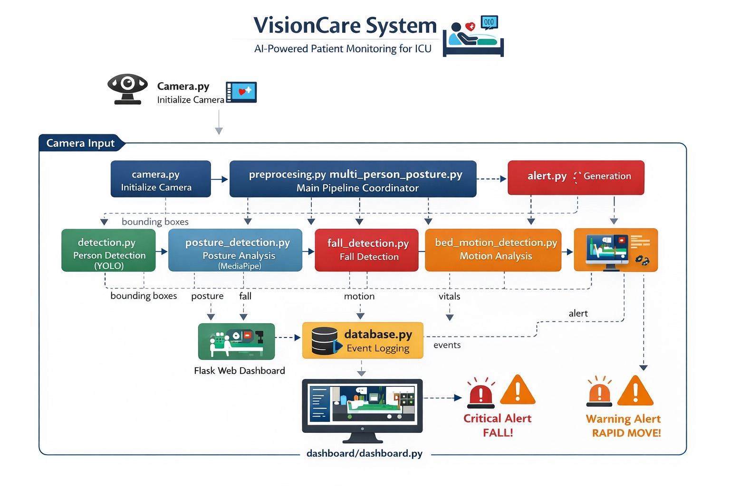
System Architecture Diagram

Slide 8
Description
The VisionCare system architecture represents a modular and integrated pipeline for real-time patient monitoring in ICU environments. The process begins with camera initialization using camera.py, which captures live video input. The data is then passed to the main pipeline coordinated by preprocessing and multi-person posture handling, where frames are enhanced and prepared for further analysis. The system performs person detection using YOLO in detection.py, generating bounding boxes for each individual. These detected regions are analyzed in posture_detection.py using MediaPipe to classify patient posture. Additional modules such as fall_detection.py and bed_motion_detection.py further analyze posture and movement patterns to identify critical events like falls and rapid movements. The alert.py module generates alerts based on detected anomalies, while database.py logs all events with relevant details and timestamps. The processed information is visualized through a Flask-based dashboard, which displays live monitoring, event logs, and alerts such as critical fall warnings and rapid movement notifications, enabling timely medical intervention.

Slide 9
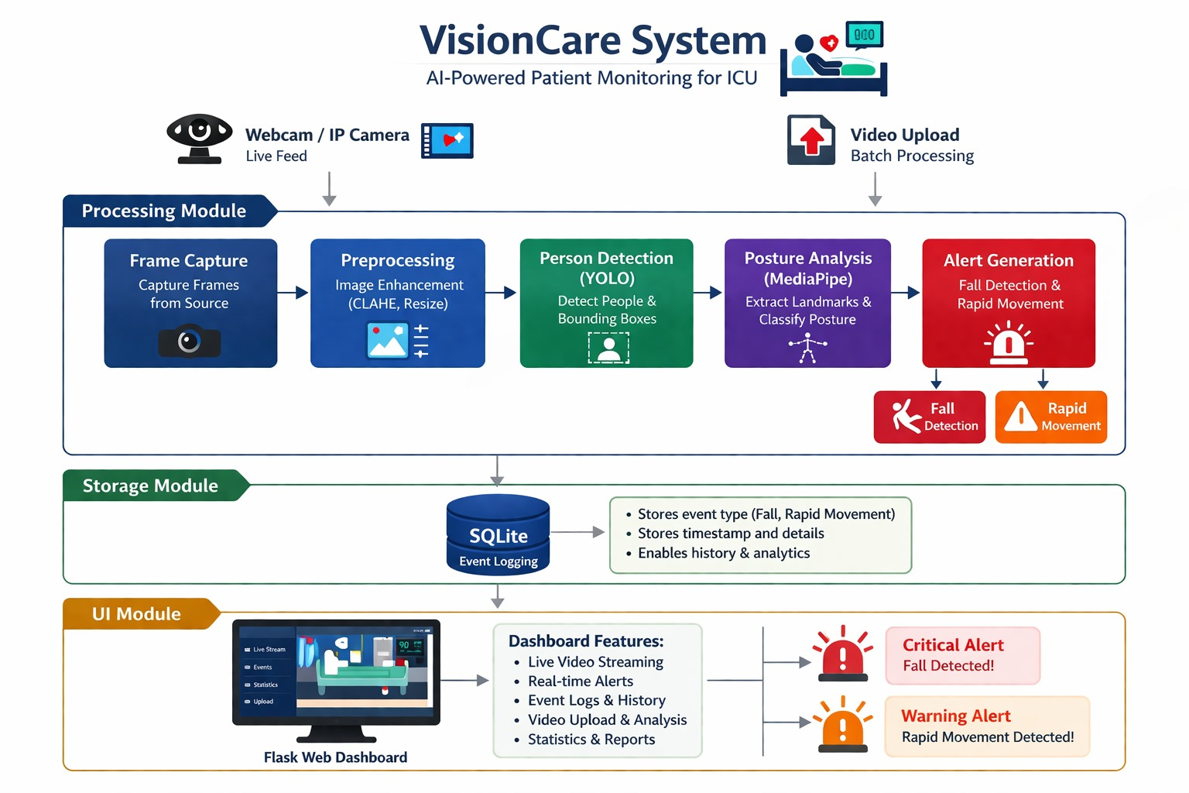
Module Connectivity Diagram

Slide 10
Description
The VisionCare system is an AI-powered patient monitoring solution designed specifically for ICU and hospital environments to ensure continuous and efficient patient supervision. It captures real-time video streams from webcams or IP cameras and also supports video uploads for batch processing. The system processes the input through a structured pipeline that includes frame capture, image preprocessing (such as resizing and enhancement), and person detection using YOLO to identify multiple patients in a scene. It then performs posture analysis using MediaPipe to extract body landmarks and classify patient positions such as standing, sitting, or lying. Based on this analysis, the system detects critical events like falls and rapid movements, which may indicate potential health risks. When such events are identified, the system generates immediate alerts to notify medical staff. All detected events are securely stored in an SQLite database along with timestamps and relevant details, enabling history tracking and analysis. Additionally, a Flask-based web dashboard provides features such as live video streaming, real-time alerts, event logs, video upload analysis, and statistical reports, allowing healthcare professionals to monitor patients effectively and respond promptly to emergencies.

Slide 11
Existing Approaches (Literature Survey)
Base Paper : A Robust and Automated Vision-Based Human Fall Detection System Using 3D Multi-Stream CNNs with an Image Fusion Technique Link: https://www.mdpi.com/2076-3417/13/12/6916 Published: 1 June 2023
Summary : This paper proposes an automated fall detection system using video footage captured from surveillance cameras. The method uses a multi-stream 3D convolutional neural network (CNN) combined with image fusion and human segmentation preprocessing to identify sequences of actions that represent a fall. The model processes groups of video frames to capture spatial and temporal movement cues, achieving high accuracy (over 99%) on public datasets. The system alerts caregivers when a fall occurs, making it useful for patient or elderly monitoring in healthcare settings.

Slide 12
Existing Approaches (Literature Survey)
S.NO | Title | Year | Methodology | Results
1. | Continuous patient monitoring with AI: real‑time analysis of video in hospital care settings | 2025 | AI‑driven continuous video analysis using object detection, role classification, and motion estimation; cloud aggregation. | Achieved strong performance in object detection (macro F1‑score ~0.92) and patient role classification (F1 ~0.98), enabling reliable monitoring of isolation and movement patterns.
2. | Deep feature fusion with computer vision driven fall detection approach for enhanced assisted living safety | 2024 | Deep Feature Fusion (MobileNet + DenseNet + ResNet), Gaussian filtering, IPOA hyperparameter tuning, denoising autoencoder classifier. | Superior fall detection accuracy (~99.68%) on benchmark datasets; effective noise elimination and deep feature fusion

Slide 13
Existing Approaches (Literature Survey)
S.NO | Title | Year | Methodology | Results
3. | Vision‑Based Fall Detector for Elderly Based on Sliding Window Approach and Feature Engineering | 2025 | Sliding window motion analysis + feature engineering with principal component analysis + gradient boosting classification. | High detection accuracy (~96%) with low processing time, practical for real‑time fall monitoring.
4. | LFD‑YOLO: a lightweight fall detection network with enhanced feature extraction & fusion | 2025 | YOLO‑based lightweight vision model with enhanced feature fusion for fall detection. | Demonstrated efficient fall detection with improved feature extraction and real‑time applicability.

Slide 14
Existing Approaches (Literature Survey)
S.NO | Title | Year | Methodology | Results
5. | ElderFallGuard: Real‑Time IoT & Computer Vision‑Based Fall Detection System for Elderly Safety | 2025 | Computer vision + IoT; MediaPipe pose estimation + random forest classifier + alert logic | Achieved 100% accuracy, precision, recall, and F1 in fall detection on custom dataset; real‑time alerts included.
6. | Fall Detection by Deep Learning‑Based Bimodal Movement & Pose Sensing with Late Fusion | 2025 | Bimodal sensing (inertial + visual pose) using deep autoencoder + attention network with late fusion. | Improved robustness in fall detection compared to single‑modality methods (results pending full metrics).
7. | Vision‑Based Activity Recognition for Unobtrusive Monitoring of the Elderly | 2025 | Computer vision + anomaly detection for video‑based daily activity recognition of elderly subjects. | Showed promise for recognizing patterns and anomalies in elderly movement data without wearables.

Slide 15
Existing Approaches (Literature Survey)
S.NO | Title | Year | Methodology | Results
8. | Real‑Time Human Action Recognition for Assisted Living | 2025 | Vision‑based action recognition using deep learning (CNN/LSTM) for assistive behavior classification. | Demonstrated effectiveness in classifying assisted living activities including falls and distress.
9. | Research on Fall Detection Based on Vision & Wearable Devices | 2025 | Review of hybrid vision and wearable sensor approaches for fall detection. | Highlights the benefits and limitations of integrated vision + sensor systems; identifies opportunities for pure vision methods.
10. | Vision‑Based Monitoring for Healthcare Safety (Sci Rep / related) | 2025 | Advanced YOLO or enhanced object detection + temporal motion analysis for real‑time healthcare event detection. | Advanced YOLO or enhanced object detection + temporal motion analysis for real‑time healthcare event detection.

Slide 16
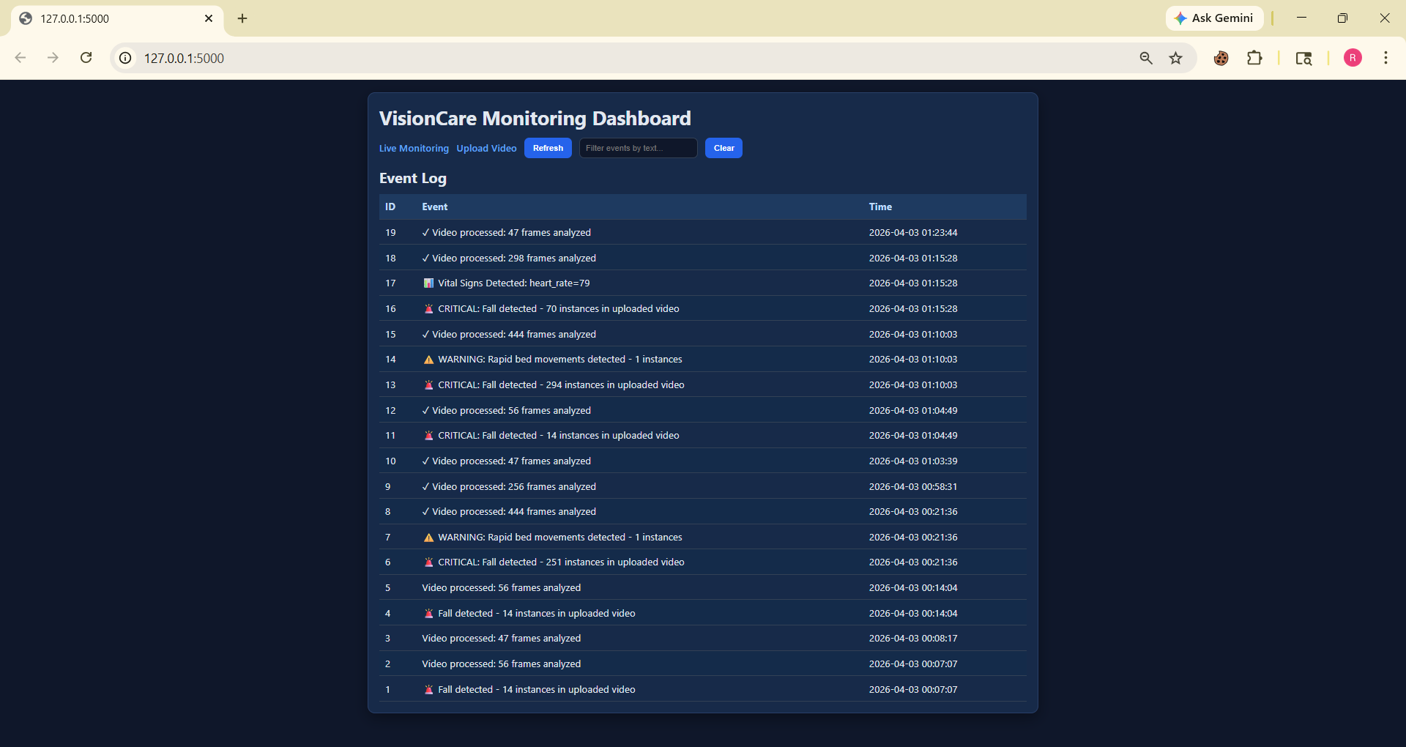
Proposed Method : Experiment Results
The VisionCare dashboard provides a centralized interface for real-time patient monitoring and alert management. It displays live video streams, detected patient activities, and posture status, along with instant alerts for critical events such as falls or rapid movements. The dashboard also maintains event logs with timestamps, enabling medical staff to track patient history, analyze incidents, and respond quickly to emergencies.

Slide 17
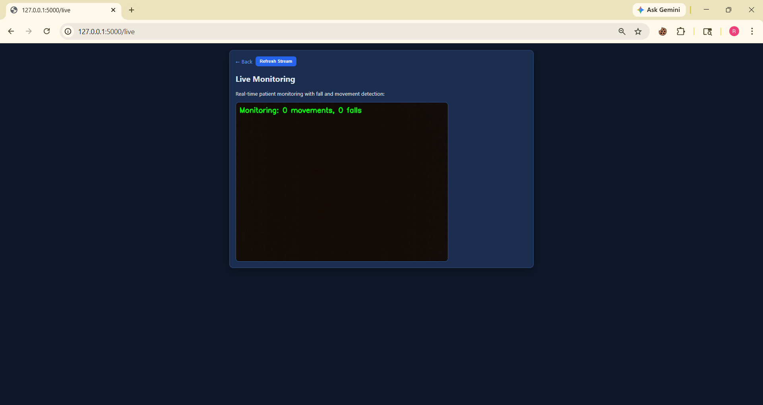
Proposed Method : Experiment Results
The VisionCare dashboard supports live video streaming with real-time detection of patient activities. It continuously displays the camera feed while overlaying detection results such as bounding boxes, posture classification, and alerts. This allows medical staff to visually monitor patients and instantly identify critical situations like falls or abnormal movements as they occur.

Slide 18
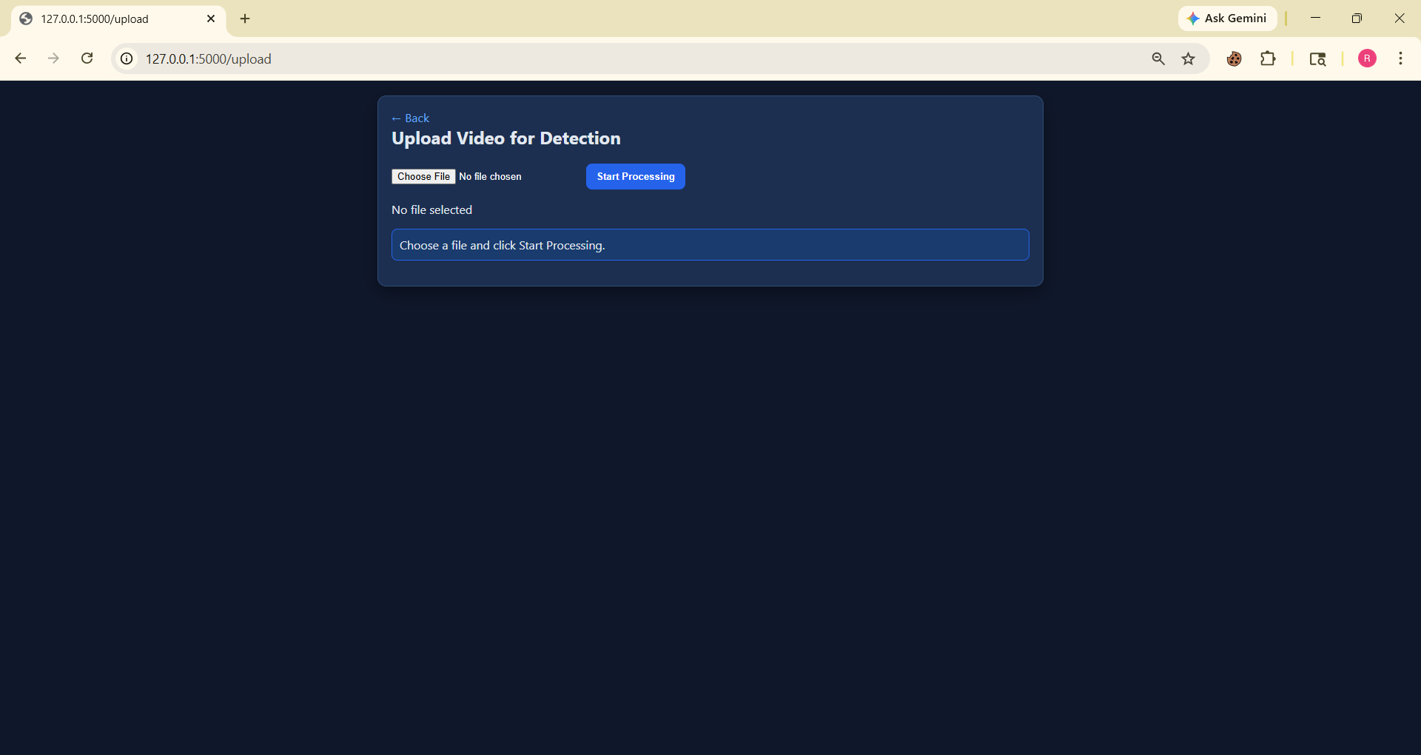
Proposed Method : Experiment Results
The VisionCare video upload page allows users to upload recorded videos for offline analysis and monitoring. The system processes the uploaded video through the same detection pipeline, including person detection, posture analysis, and event detection. It identifies critical events such as falls or rapid movements and displays the results along with visual overlays.

Slide 19
Test Cases for the Project
S. No | Feature | Test Case Description | Input | Expected Output | Status | Expected Output Link
[1] | Fall Detection | Test detection of various persons in a video | A Video with multiple objects. | Alert for fall detection | Pass | Drive Link
[2] | Rapid Movements | Test detection of patients in a video. | A video with patients . | Alert for rapid movements for distress | Pass | Drive Link
[3] | No fall | Test recognition of persons in a video. | A video of a well person. | No alerts | Pass | Drive Link

Slide 20
Software & Hardware Requirements
Software Requirements
Hardware Requirements
Operating System: Windows / Linux
Programming Language: Python
Libraries & Frameworks:
OpenCV – Image processing
MediaPipe / PoseNet – Human pose estimation
TensorFlow / PyTorch – Deep learning
Flask / Django – Web application
Database: MySQL
Tools: VS Code, Jupyter Notebook
CCTV / IP Camera
Computer / Server
Internet connectivity
Monitor display for dashboard
Optional: Edge device (Raspberry Pi)

Slide 21
Gaps Identified
Limited Continuous Monitoring: Manual observation cannot provide uninterrupted monitoring for all patients at all times.
Dependency on Wearable Sensors: Sensor-based systems may cause discomfort, require maintenance, and are prone to failure or misuse.
Delayed Emergency Detection: Critical incidents such as falls may not be noticed immediately, leading to delayed medical response.
Lack of Intelligence in CCTV Systems: Traditional CCTV systems only record footage and do not automatically detect abnormal events.
High Workload on Medical Staff: Continuous patient supervision increases the burden on nurses and caregivers.

Slide 22
References
[1]Wang,H.etal.(2025)LFD-YOLO: A Lightweight Fall Detection Network with EnhancedFeature Extraction
https://www.nature.com/search?q=LFD-YOLO+Lightweight+Fall+Detection
[2]Kothari, V. P., & Chakurkar, P. S. (2025)
YOLO and MediaPipe-Based Human Fall Detection System with Alert Automation https://pubmed.ncbi.nlm.nih.gov/?term=YOLO+MediaPipe+fall+detection
[3] Xun, J. et al. (2025)
Efficient Fall Detection Using YOLOv8n in Challenging Environments
https://www.nature.com/search?q=YOLOv8n+fall+detection
[4].Riahi, T. et al. (2025)
ElderFallGuard: Real-Time IoT and Vision-Based Fall Detection System
https://arxiv.org/search/?query=ElderFallGuard&searchtype=all

Slide 23
References
[5]. Wang, Y. (2024). IoT-Based Fall Detection System Using YOLOv5 and OpenPose. Highlights in Science and Engineering.
https://drpress.org/ojs/index.php/HSET/search?q=YOLOv5+OpenPose+fall+detection
[6] Gabriel, P. et al. (2024). Continuous Patient Monitoring with AI Using Video Analysis in Hospitals. arXiv.
https://arxiv.org/search/?query=patient+monitoring+video+AI&searchtype=all
[7] Terven, J. & Cordova-Esparza, D. (2023). A Comprehensive Review of YOLO Architectures. arXiv.
https://arxiv.org/abs/2304.00501
[8]Alam, E. et al. (2022). Vision-Based Human Fall Detection Systems Using Deep Learning: A Review. arXiv.
https://arxiv.org/abs/2207.10952
[9].Zhang, Z. et al. (2020). Vision-Based Patient Monitoring Using Deep Learning. IEEE.
https://ieeexplore.ieee.org/search/searchresult.jsp?queryText=vision%20based%20patient%20monitoring%20deep%20learning

Slide 24
References
[10].Feichtenhofer, C. et al. (2019). SlowFast Networks for Video Recognition. ICCV.
https://arxiv.org/abs/1812.03982
[11] Cao, Z. et al. (2017). OpenPose: Real-Time Multi-Person 2D Pose Estimation. IEEE.
https://arxiv.org/abs/1812.08008
[12] Litjens, G. et al. (2017). A Survey on Deep Learning in Medical Image Analysis. Medical Image Analysis.
https://www.sciencedirect.com/science/article/pii/S1361841517301135
[13] Carreira, J. & Zisserman, A. (2017). Quo Vadis, Action Recognition? A New Model and the Kinetics Dataset (I3D). CVPR.
https://arxiv.org/abs/1705.07750
[14] Redmon, J. et al. (2016). You Only Look Once: Unified Real-Time Object Detection. IEEE CVPR.
https://arxiv.org/abs/1506.02640

Slide 25
References
[15] He, K. et al. (2016). Deep Residual Learning for Image Recognition (ResNet). IEEE.
https://arxiv.org/abs/1512.03385
[16]Donahue, J. et al. (2015). Long-term Recurrent Convolutional Networks (LRCN). CVPR.
https://arxiv.org/abs/1411.4389
[17]Tran, D. et al. (2015). C3D: Learning Spatiotemporal Features for Video Analysis. ICCV.
https://arxiv.org/abs/1412.0767
[18] Simonyan, K. & Zisserman, A. (2014). Two-Stream CNN for Action Recognition. NIPS.
https://arxiv.org/abs/1406.2199
[19] Mubashir, M. et al. (2013). A Survey on Fall Detection Systems. Neurocomputing.
https://www.sciencedirect.com/science/article/pii/S0925231213004377
[20] Aggarwal, J. & Ryoo, M. (2011). Human Activity Analysis: A Review. ACM.
https://dl.acm.org/doi/10.1145/1922649.1922653

